Slide 2
walkthrough the basics of Git and GitHub concepts.

Slide 3
What is Version Control System (VCS)?
Version Control Systems are the software tools for tracking/managing all the changes made to the source code during the project development. It keeps a record of every single change made to the code.
It also allows us to turn back to the previous version of the code if any mistake is made in the current version. Without a VCS in place, it would not be possible to monitor the development of the project.

Slide 4
Types of VCS
The three types of VCS are:
Local Version Control System
Centralized Version Control System
Distributed Version Control System

Slide 5
Local Version Control System
Local Version Control System is located in your local machine. If the local machine crashes, it would not be possible to retrieve the files, and all the information will be lost. If anything happens to a single version, all the versions made after that will be lost.

Slide 6
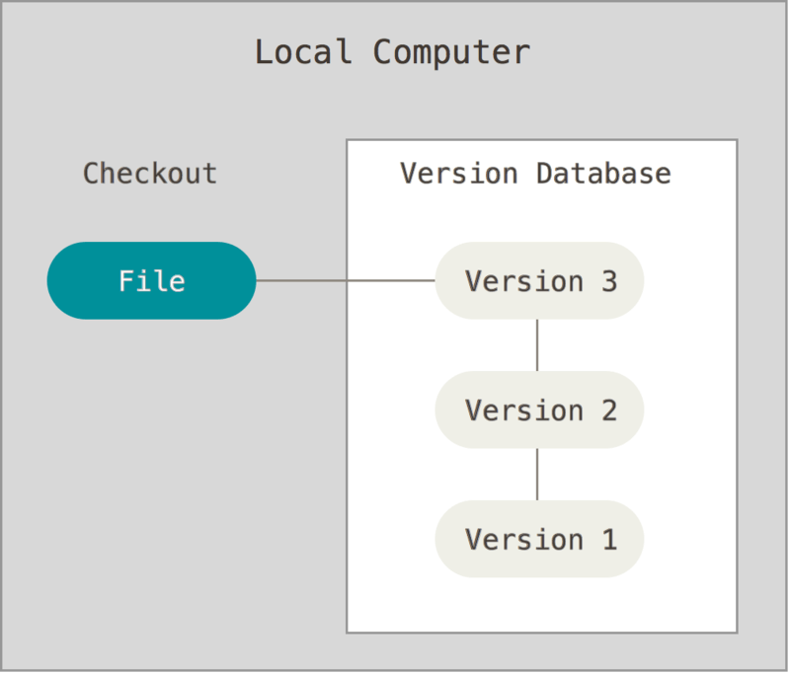
Local Version Control System
With the Local Version Control System, it is not possible to collaborate with other collaborators.

Slide 7
Centralized Version Control System
To collaborate with other developers on other systems, Centralized Version Control Systems are developed.
In the Centralized Version Control Systems, there will be a single central server that contains all the files related to the project, and many collaborators checkout files from this single server (you will only have a working copy).
The problem with the Centralized Version Control Systems is if the central server crashes, almost everything related to the project will be lost.

Slide 8
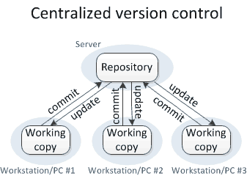
Centralized Version Control System
To overcome all the above problems, Distributed Version Control Systems are developed.

Slide 9
Distributed Version Control System
In a distributed version control system, there will be one or more servers and many collaborators similar to the centralized system.
But the difference is, not only do they check out the latest version, but each collaborator will have an exact copy (mirroring) of the main repository(including its entire history) on their local machines.

Slide 10
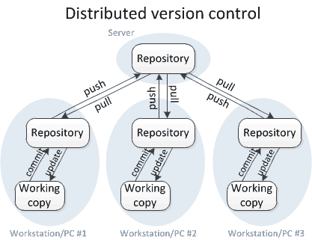
Distributed Version Control System
Each user has their own repository and a working copy. This is very useful because even if the server crashes we would not lose everything as several copies are residing in several other computers.

Slide 11
Difference between Git and GitHub
Git is a version control tool (software) to track the changes in the source code.
GitHub is a web-based cloud service to host your source code(Git repositories). It is a centralized system.
Git doesn’t require GitHub but GitHub requires Git.

Slide 12
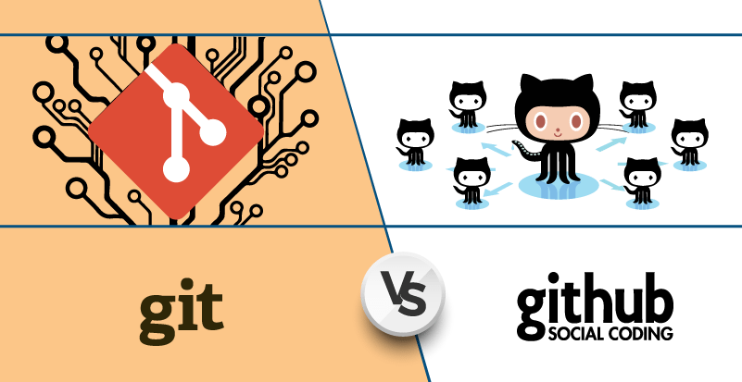
Difference between Git and GitHub

Slide 13
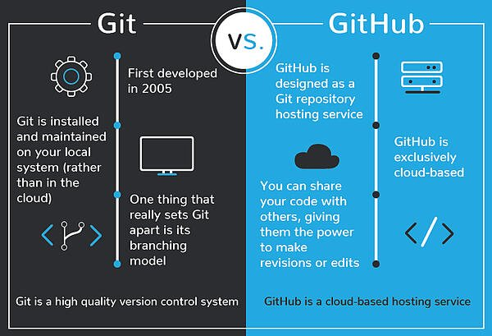
Difference between Git and GitHub

Slide 14
What exactly is GitHub?
To be very crisp about what exactly is GitHub, it is a file or code-sharing service to collaborate with different people.
GitHub is a highly used software that is typically used for version control.
It is helpful when more than just one person is working on a project. Say for example, a software developer team wants to build a website and everyone has to update their codes simultaneously while working on the project. In this case, Github helps them to build a centralized repository where everyone can upload, edit, and manage the code files.

Slide 15

Why is GitHub so popular?
GitHub has various advantages but many people often have a doubt as to why not use drobox or any cloud based system?

Slide 16
Same example
Let me take the same example forward to answer this question
Say more than two software developers are working on the same file and they want to update it simultaneously. Unfortunately, the person who save the file first will get precedence over the others.

Slide 17
GitHub
While in GitHub, this is not the case. GitHub document the changes and reflect them in an organized manner to avoid any chaos between any of the files uploaded.
Therefore using GitHub centralized repository, it avoids all the confusion and working on the same code becomes very easy.

Slide 18
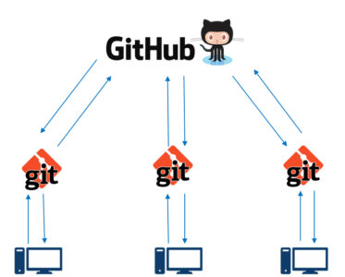
GitHub
If you look at the image on the left, GitHub is a central repository and Git is a tool which allows you to create a local repository. Now people usually get confused between git and GitHub but its actually very different.
Git is a version control tool that will allow you to perform all kinds of operations to fetch data from the central server or push data to it whereas GitHub is a core hosting platform for version control collaboration. GitHub is a company that allows you to host a central repository in a remote server.

Slide 19
GitHub makes git simple
GitHub provides you a beautiful visual interface which helps you to track or manage your version controlled projects locally.
Once you register on GitHub, you can connect with social network and build a strong profile.

Slide 20
How to create a GitHub Repository?
A repository is a storage space where your project lives. It can be local to a folder on your computer, or it can be a storage space on GitHub or another online host. You can keep code files, text files, images or any kind of a file in a repository.
You need a GitHub repository when you have done some changes and are ready to be uploaded. This GitHub repository acts as your remote repository.

Slide 21

How to create a GitHub Repository?
Simple steps to create a GitHub repository:

Slide 22
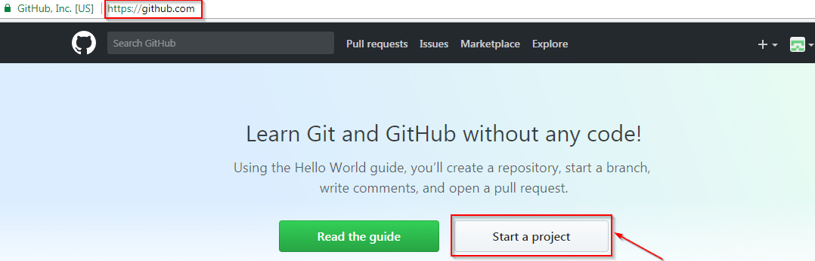
Start a new project
Go to the link: https://github.com/ . Fill the sign up form and click on “Sign up for Github”.
Click on “Start a new project”.
Refer to the below screenshot to get a better understanding.

Slide 23
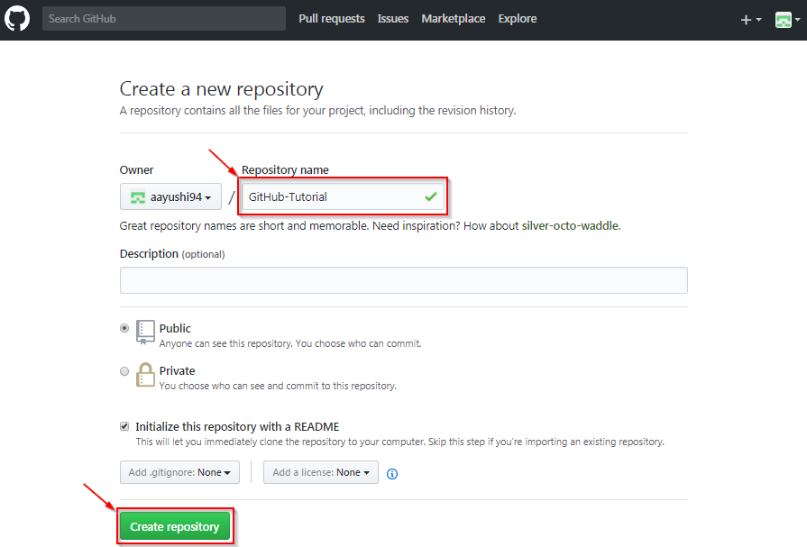
Repository name
Enter any repository name and click on “Create Repository”. You can also give a description to your repository (optional).

Slide 24
GitHub repository
Now, if you noticed by default a GitHub repository is public which means that anyone can view the contents of this repository whereas in a private repository, you can choose who can view the content.
Also, private repository is a paid version. Also, if you refer the above screenshot, initialize the repository with a README file. This file contains the description of the file and once you check this box, this will be the first file inside your repository

Slide 25
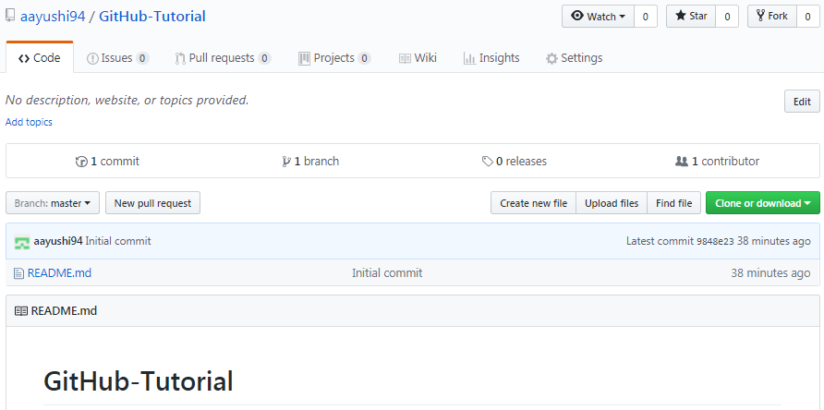
Repository is successfully created
Congratulations, your repository is successfully created! It will look like the below screenshot:

Slide 26
Repository is successfully created
So now central repository has been sucessfully created! Once this is done, you are ready to commit, pull, push and perform all the other operations.
Now let’s move forward and understand branching in GitHub

Slide 27
Create Branches and Perform Operations
Branching: Branches help you to work on different versions of a repository at one time. Let’s say you want to add a new feature (which is in the development phase), and you are afraid at the same time whether to make changes to your main project or not.
This is where git branching comes to rescue. Branches allow you to move back and forth between the different states/versions of a project

Slide 28
Commit Command
This operation helps you to save the changes in your file. When you commit a file, you should always provide the message, just to keep in the mind the changes done by you.
Though this message is not compulsory but it is always recommended so that it can differentiate the various versions or commits you have done so far to your repository.

Slide 29
Pull command
Pull command is the most important command in GitHub. It tell the changes done in the file and request other contributors to view it as well as merge it with the master branch.
Once the commit is done, anyone can pull the file and can start a discussion over it.

Slide 30
Merge Command
Here comes the last command which merge the changes into the main master branch.

Slide 31
Installation of Git
1. Install Git for using WSL (Windows Subsystem for Linux).
2. Install Git software for windows.

Slide 32
Git operations and commands
Before deep-diving into Git operations and commands, create an account for yourself on GitHub if you don’t have it already.
5 Git operations and commands

Slide 33
Create repositories
Create a remote central repository on GitHub.
Open your file explorer, navigate to the working directory, right-click and select “Git Bash Here”. This opens the Git terminal. To create a new local repository use the command git init and it creates a folder .git.
git init to create a new Git repository

Slide 34
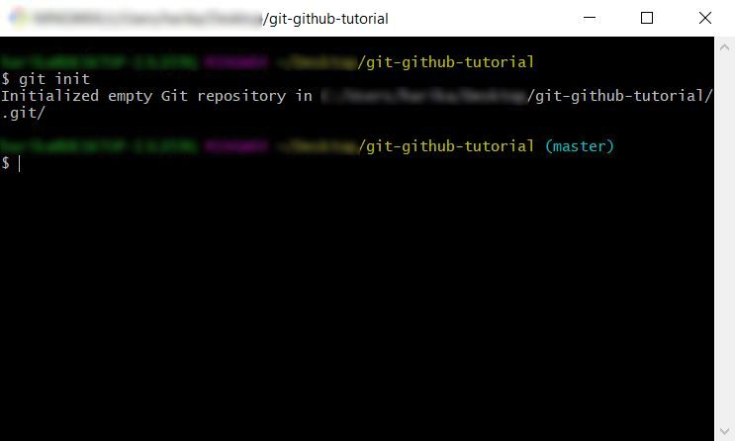
git init
(master) is the default branch of the local repository.
Next, we need to sync the local and the central repositories.

Slide 35
Git remote add to add a new remote repository.
To get the URL of the central repo, open your repository in GitHub and copy the link.
Run the below command,
$ git remote add origin "https://github.com/harika-bonthu/git-github-tutorial.git"
Generally, Origin is the shorthand name of the remote repository that we are cloning.

Slide 36
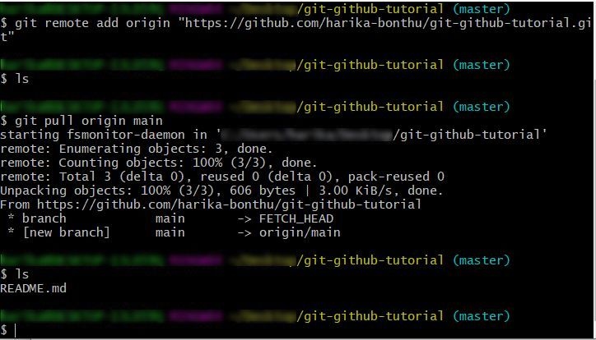
Git pull to download all the content from the remote repo
$ git pull origin main
(main is the branch in our central/remote repository. Kindly check the branch name before pull request)

Slide 37
Git status to check the status of the working directory and the staging area.
Working directory – It is the place where we make changes to the existing files or create new files.
Staging area – It is the place where the files are ready to be committed.

Slide 38
Git add to add files to the index or the staging area.
After making changes in the working directory, once again check the status using the command git status.

